Slide 1
Data Mining
Anomaly Detection
Figures for Chapter 10
Introduction to Data Mining
by
Tan, Steinbach, Kumar
© Tan,Steinbach, Kumar Introduction to Data Mining 4/18/2004 <number>

Slide 2
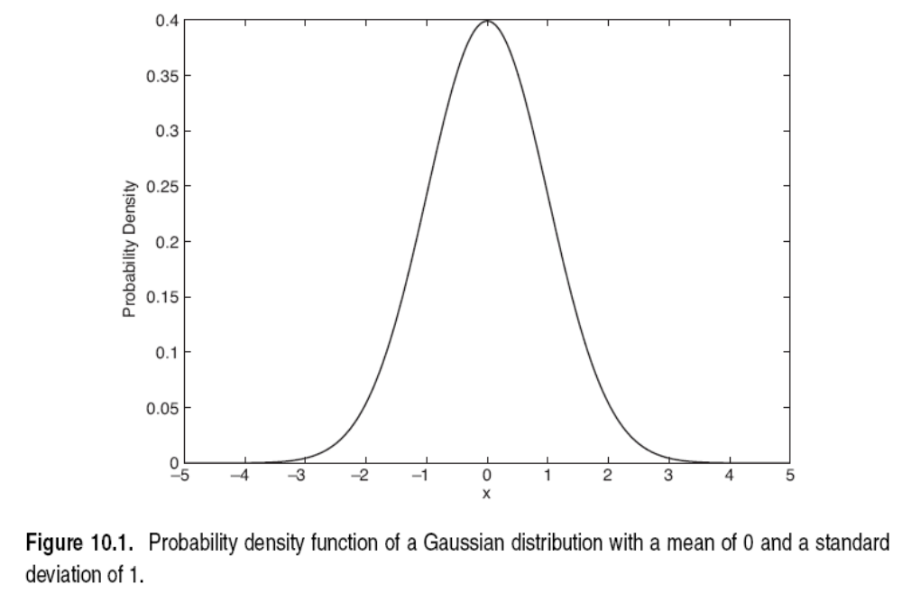

Slide 3
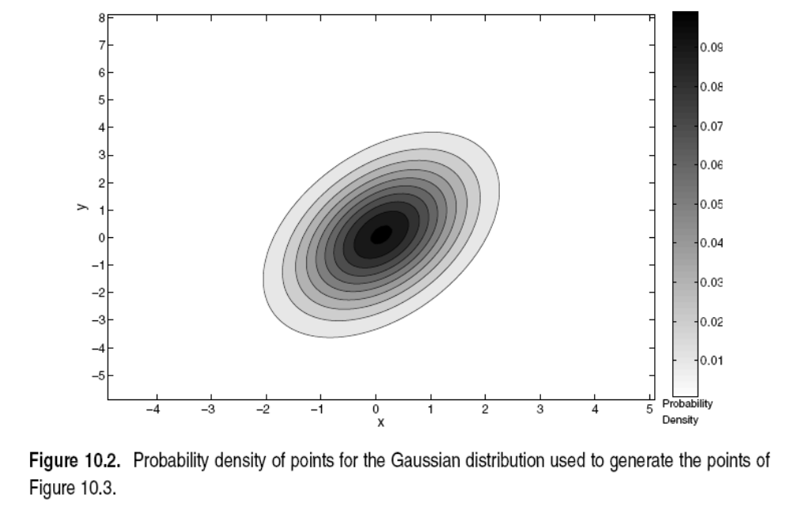

Slide 4
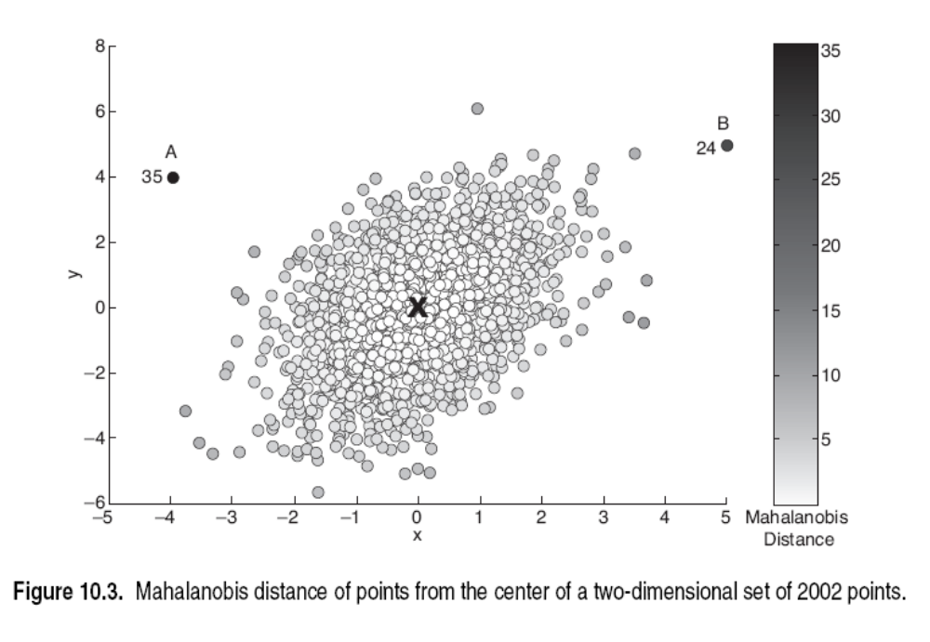

Slide 5
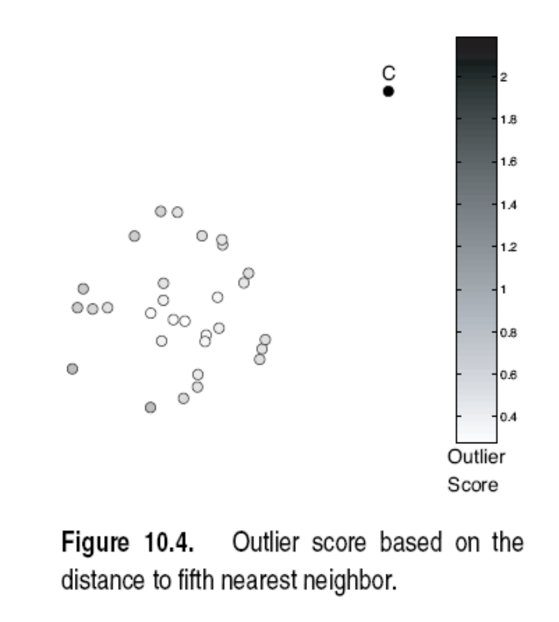

Slide 6
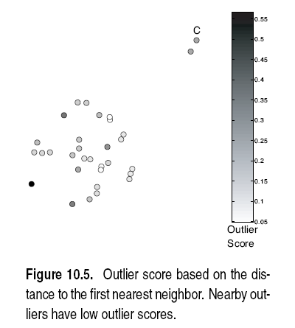

Slide 7
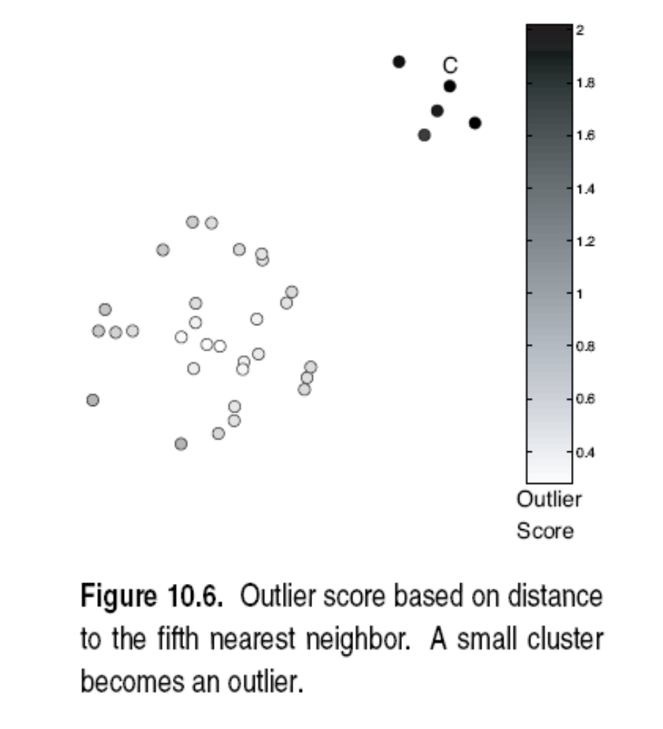

Slide 8
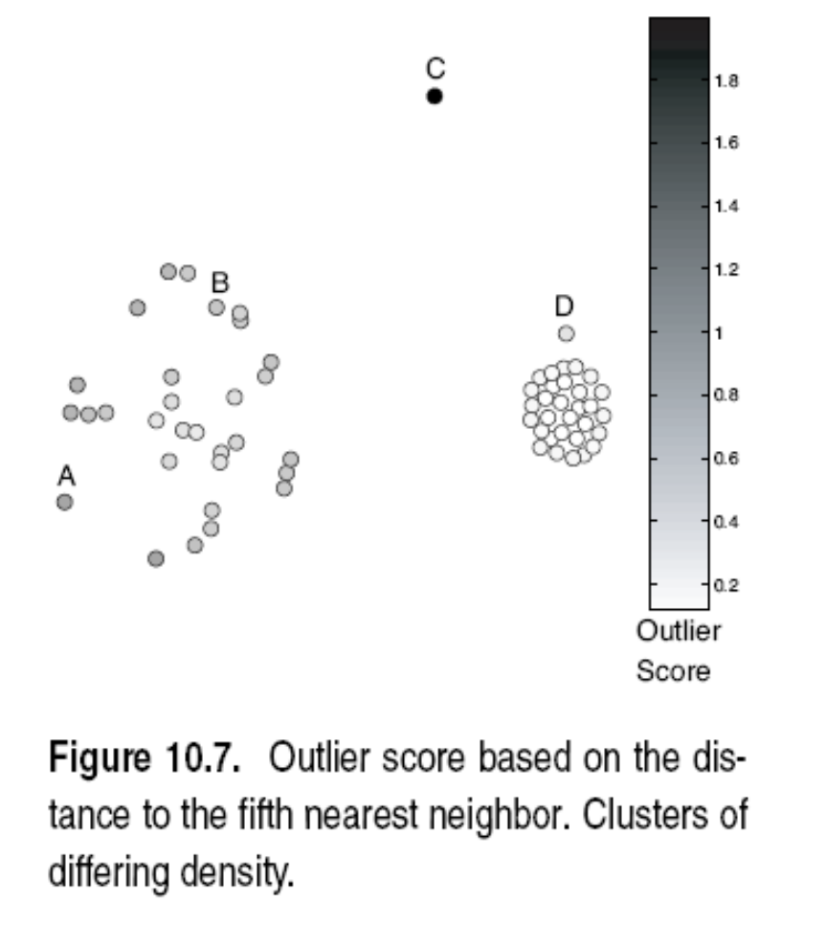

Slide 9
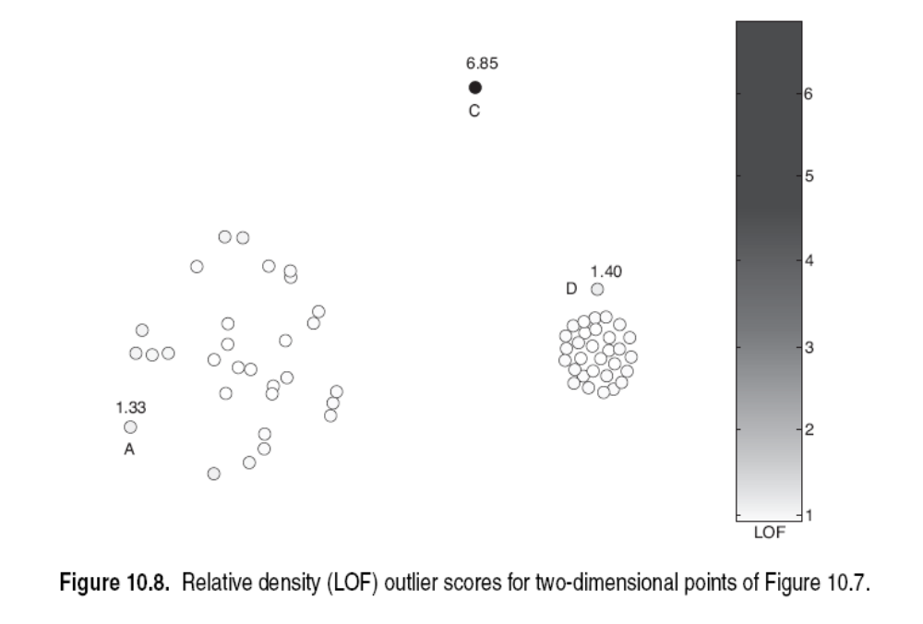

Slide 10
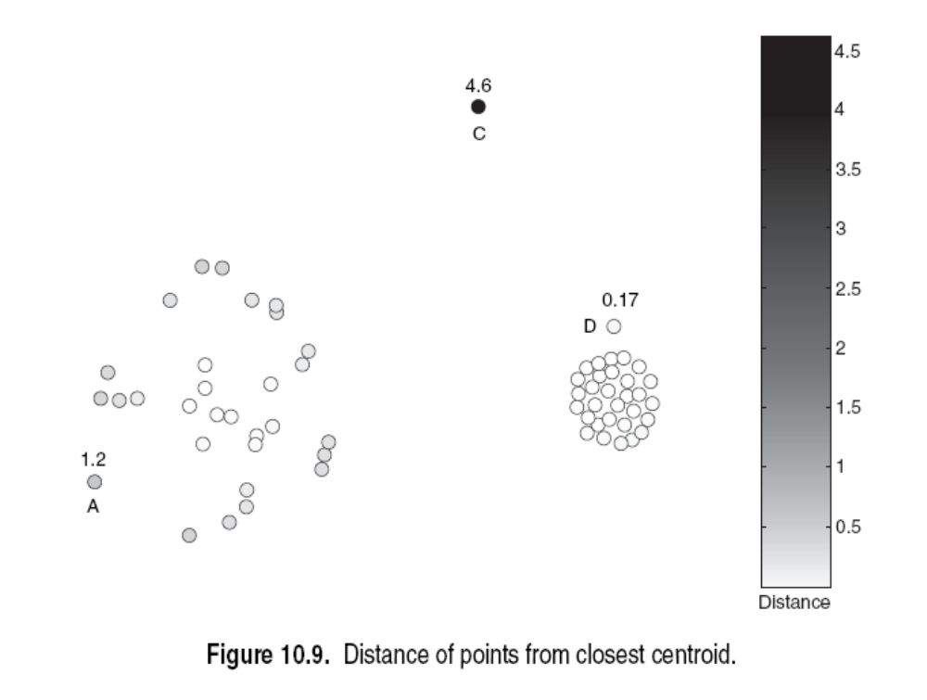

Slide 11
